Slide 1
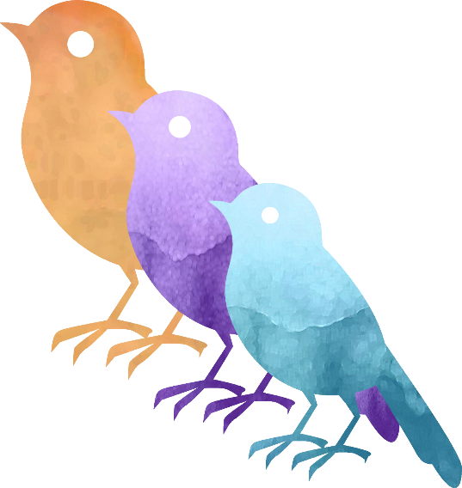
Welcome
Academic Writing
Prof. Dr. Christina Sichtmann Bern University of Applied Sciences

Slide 2
For me, writing is…

Slide 3
Excuses why we do not write:
I don’t have any time for writing.
I can’t write in my office.
I’m not ambitious.
My teaching comes first.
I review journal articles, but I don’t write for journals.
I don’t want to play the publications game.
I’m too tired when I get home to do any writing.
I resent giving up so much of my personal time to writing.
I do a lot of writing, just not for publication.
No one will read it anyway.
I’m probably just afraid of rejection.
I don’t write well.

Slide 4


Slide 5





Slide 6
Freewriting Rules
Write as fast as you can without pausing, without reading or correcting, and stop when the time has passed.

Slide 7
Why inflation is good…

Slide 8
My biggest challenge in writing right now is…

Slide 9
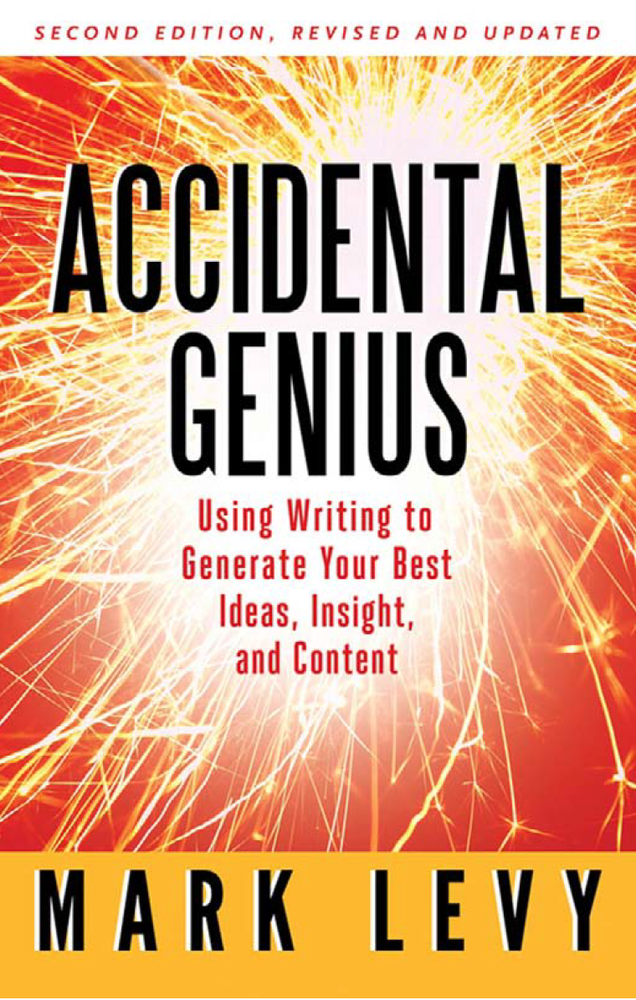

Slide 10
Circle of creation
Silence
Creativity
Action
Correction

Slide 11
In which of the four phases do you feel strong?
In which do you feel weak?

Slide 12
Do you have enough breaks?
Do you have enough sleep?
What does the thought of doing nothing evoke in you?

Slide 13
I am quite good at starting the writing but after a few weeks of working on a project, I get bored and I would do anything to stop.

Slide 14
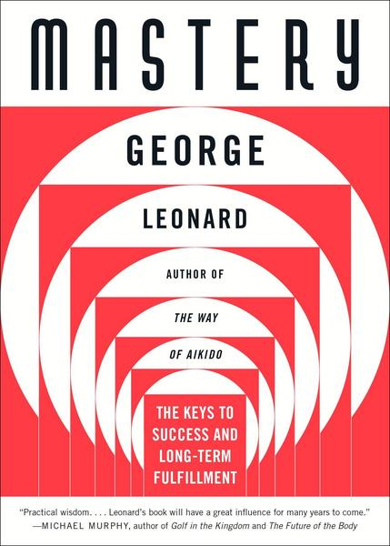
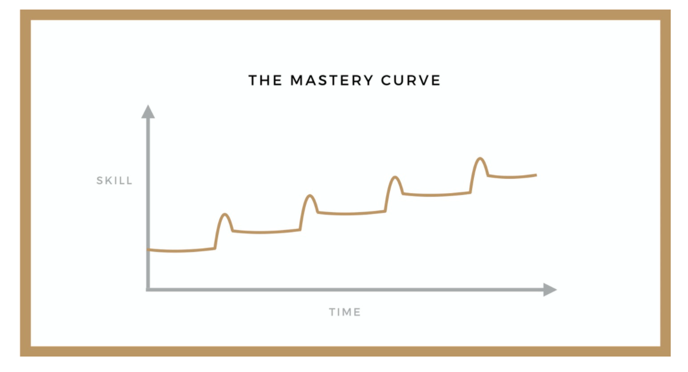
The Mastery Curve
© Hannah Frankman

Slide 15
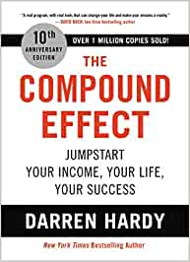
The Compound Effect
Small clever changes
+ consistency
+ time
= a radical difference

Slide 16
Do you have a morning routine?

Slide 17
A good morning routine
…reduces your stress level for the rest of the day
…helps you to live more healthy
…helps you saving your energy
…is time for yourself!
…increases your productivity

Slide 18
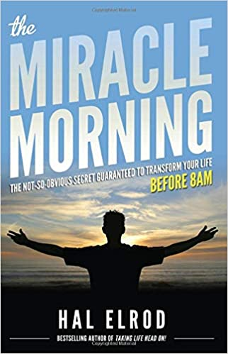
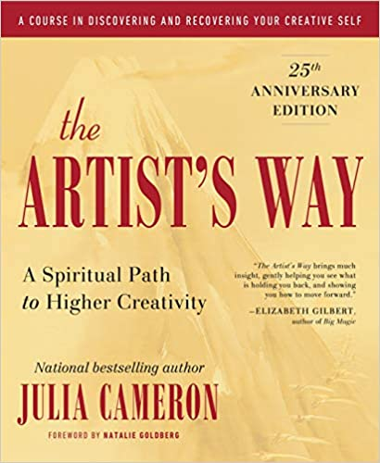
A good morning routine
Morning Pages are three pages of longhand, stream of consciousness writing, done first thing in the morning. *There is no wrong way to do Morning Pages*– they are not high art. They are not even “writing.” They are about anything and everything that crosses your mind– and they are for your eyes only. Morning Pages provoke, clarify, comfort, cajole, prioritize and synchronize the day at hand. Do not over-think Morning Pages: just put three pages of anything on the page...and then do three more pages tomorrow.
https://juliacameronlive.com/basic-tools/morning-pages/
Life SAVERS
S – Silence
A – Affirmations
V – Visualization
E – Exercise
R – Reading
S – Scribe
Notes:
S – Silence
A – Affirmations
V – Visualization
E – Exercise
R – Reading
S – Scribe

Slide 19
What do you think about (a morning) routines?
Do you have a routine?
What could be part of your morning routine?

Slide 20

Clarity
© Pixabay

Slide 21
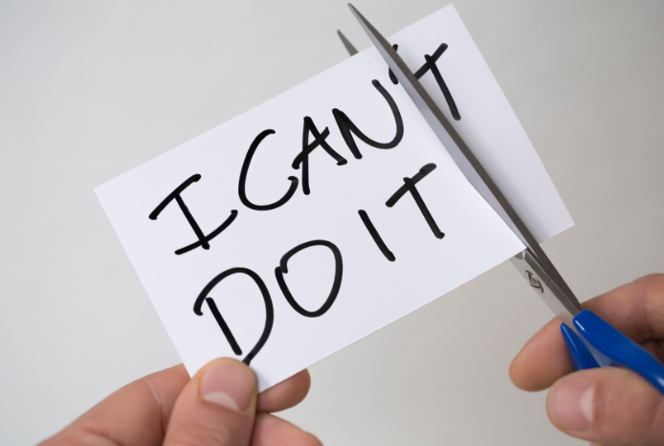
Feasibility

Slide 22

Motivation

Slide 23
Clarity + Feasibility + Motivation = Move

Slide 24
What makes a good paper?

Slide 25
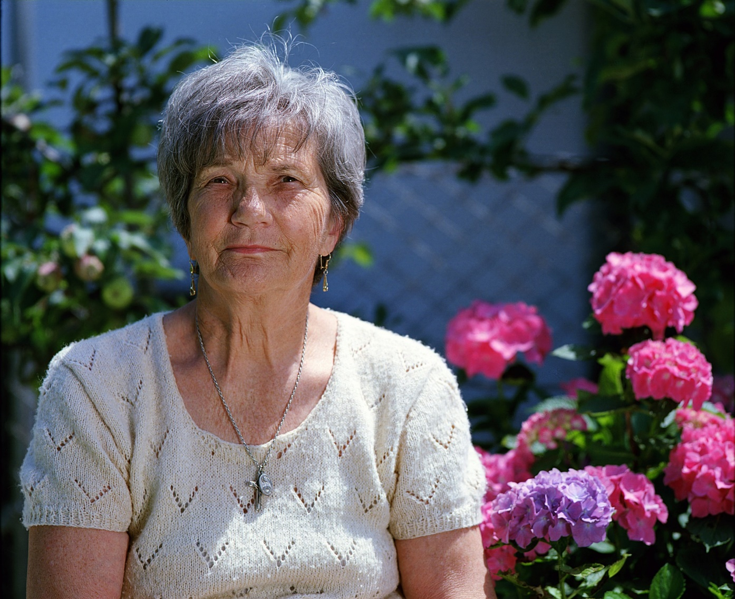
Write a letter to your aunt Emily
Dear aunt Emily,
ss promised I write you a letter today about my publication project…
With all my love.
Yours
© Benjamin Balazs on Pixabay

Slide 26
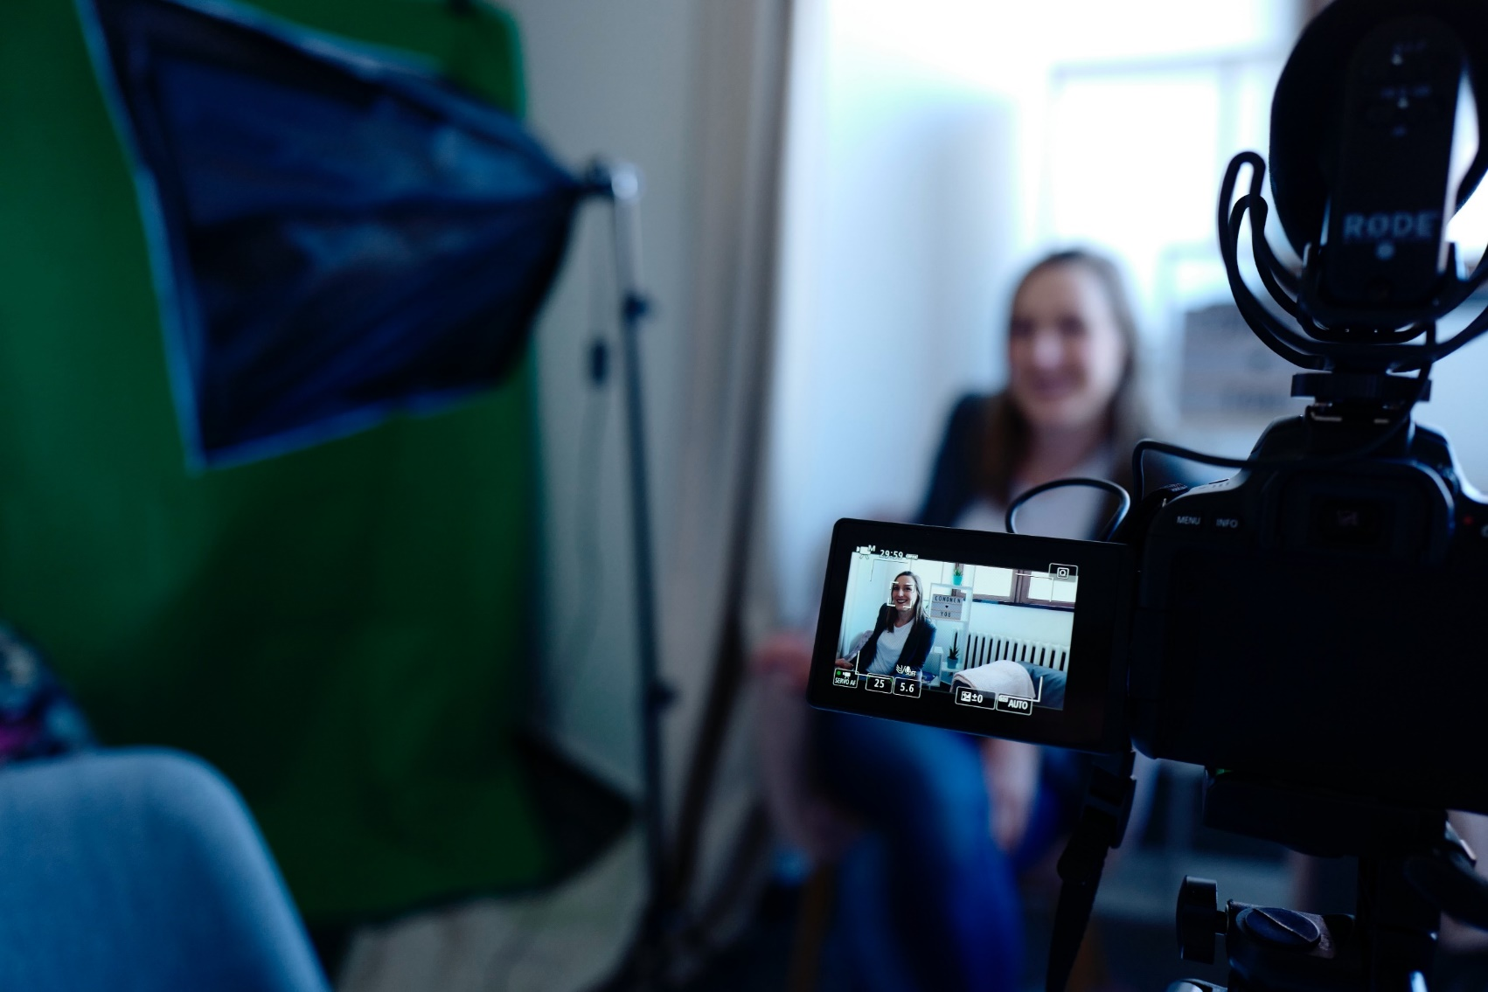
Interview with a journalist
[Your name ] emphasizes that…
© CoWomen von Pexels

Slide 27
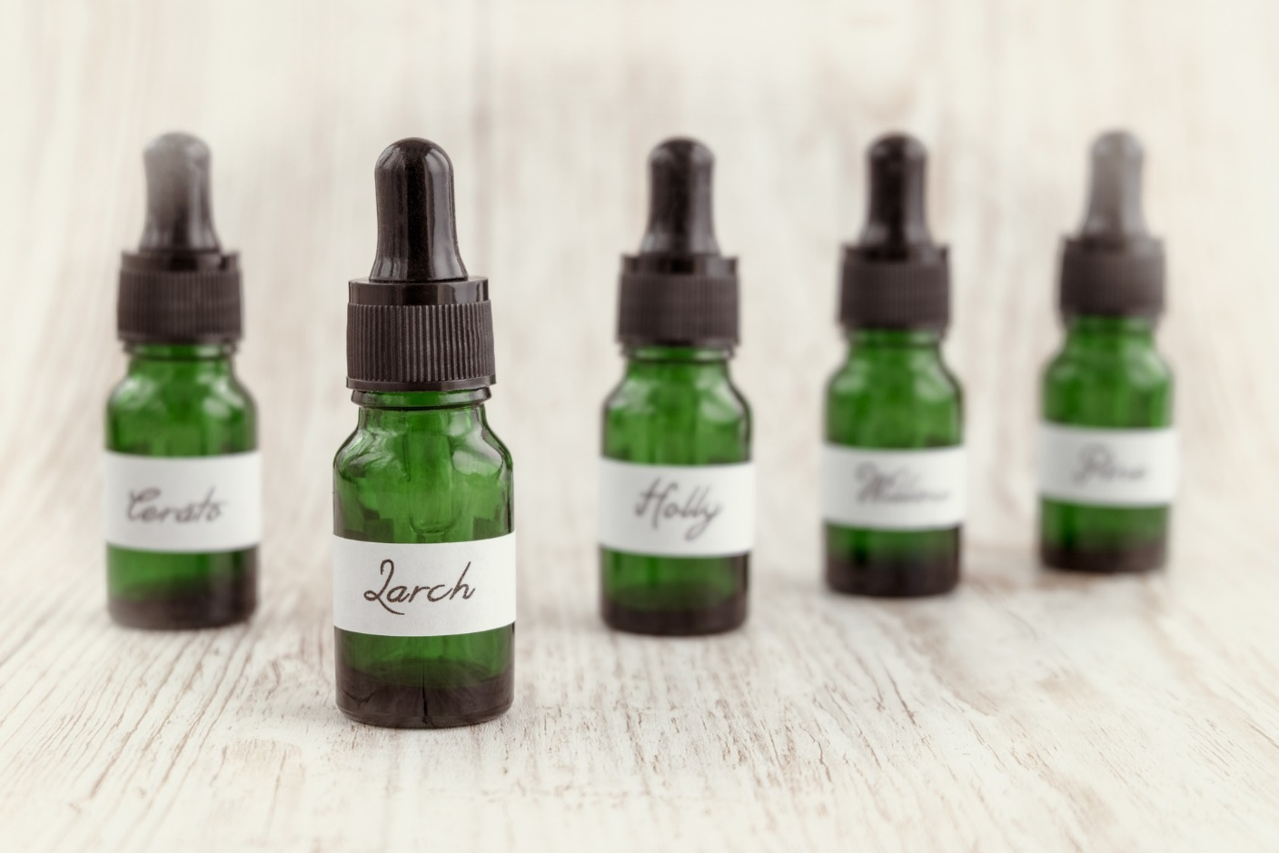
The essence of your paper
© PicsbyFran on Pixabay

Slide 28
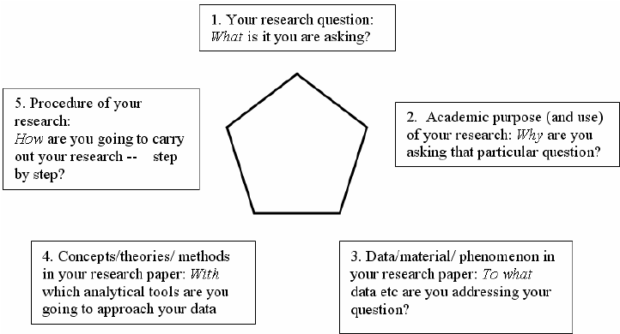
The research paper pentagon
© Rienecker 2020

Slide 29
The assumptions
You found a research topic, done the research, analyzed the data and wrote the paper.
You submit the paper to a journal
What happens?

Slide 30
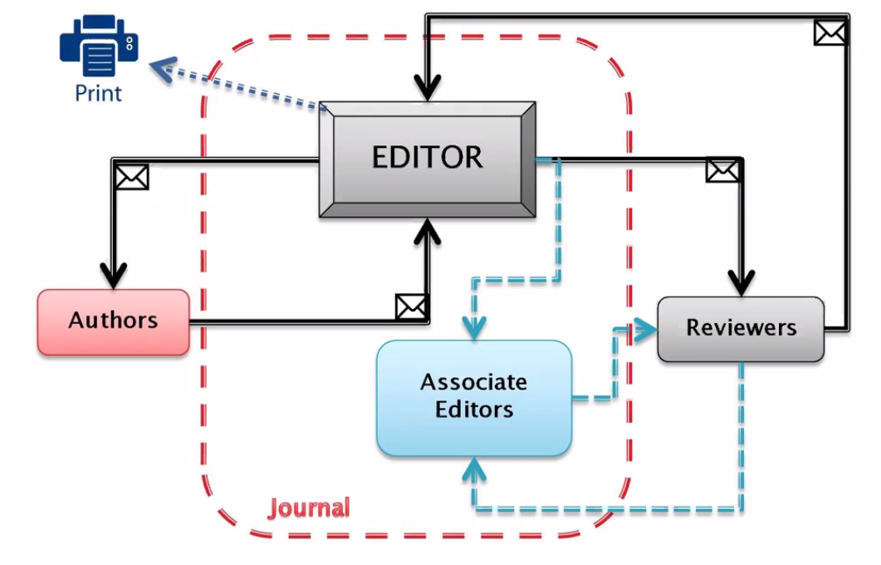
Editorial Process – Double Blind Peer-Review
Who might be reviewer?
Editorial Review Board
Authors that you cite and have published in the journal!
Who is the Editor?
Authors that you do not cite and have published in the journal!
Authors that are known in the field of research
Reviewers that have indicated your keywords as their area of expertise
Who might be the Associate Editor?
Buddies of the (Associate) Editor
…
© Adamantios Diamantopoulos

Slide 31
The assumptions
You found a research topic, done the research, analyzed the data and wrote the paper.
You submitted the paper to a journal and it was not desk-rejected, and not rejected in the first review round.
CONGRATULATIONS!
But: what follows?

Slide 32
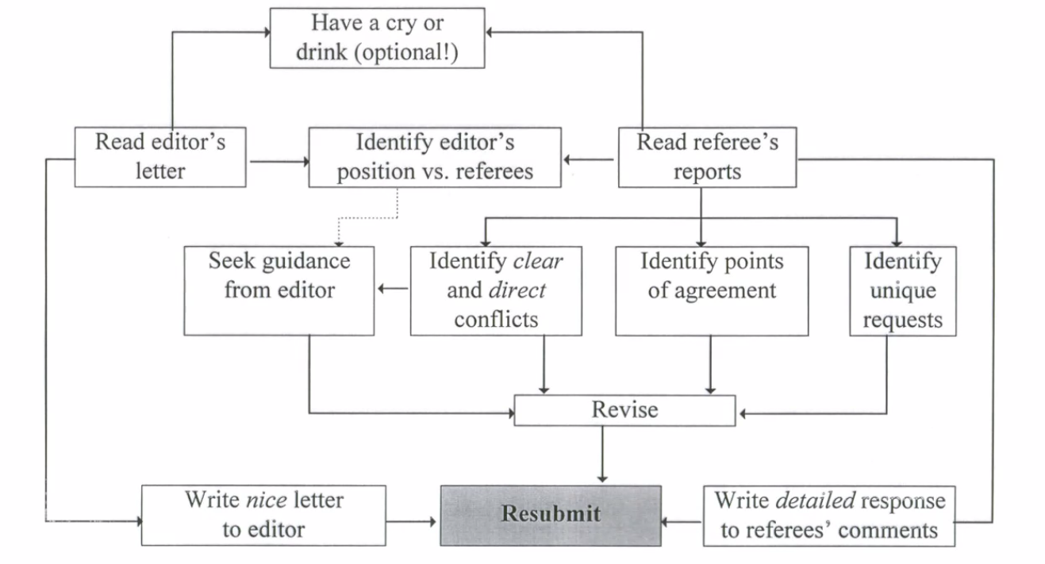
Dealing With Revisions
© Adamantios Diamantopoulos

